Slide 1

Beyond Strava: Custom Analytics for Personal Fitness Data
Alessandro Mecchia & Paolo Nicolet
Software Engineering, Modeling and Applications
Data Science & Artificial Intelligence 2024/2025

Slide 2
Problem
Strava Limitations
Key analytics (e.g., heart rate zones, pace trends) only for premium users
Limited customization & no support for custom queries or visualizations
User Constraints
No control over data processing or filtering
Restricted to default metrics and charts

Slide 3
Motivation
Why We Built This
We're active athletes who enjoy analyzing and sharing performance data
Strava’s restrictions limit the depth and flexibility we value
Our Solution
Fetch and store Strava data locally
Replicate and extend analytics features
Lay the groundwork for advanced tools like ML-driven insights

Slide 4
Overview
Modular design:
Database + Flask Backend + Python Client Library
Goal:
Enable independent storage and analysis of Strava data
Provide full control over fitness analytics outside platform restrictions
Design Focus
Extensibility: Easy to expand with new features and data types
Testability: Clean architecture supports reliable development and testing

Slide 5
Database – Mongo Atlas
Why MongoDB?
Ideal for hierarchical, semi-structured data
Naturally fits athlete profiles and activity records
Database Structure:
Database Name: strava-db
Collections:
athletes: stores ID, name, gender, weight, etc.
activities: stores activity data (type, duration, distance, timestamps, streams) linked to athletes via athlete_id

Slide 6
Backend Web Service
Framework:
Flask with Blueprints for modular route handling
Functionality:
REST API endpoints to:
Get all athletes/activities or by I
Filter activities (e.g., type, date range)
Aggregate data (e.g., total distance/week)
Generate summaries for visualizations
Tech Stack:
MongoEngine: ODM for high-level DB access
PyMongo: Used for heavy operation on DB
Design Highlights:
Service layer: handles business logic
Route layer: manages HTTP request-response
Extensible for future features

Slide 7
Client Library
Purpose:
Abstract API interactions and simplify data access for developers and analysts.
Features:
Client Class: core interface for API interaction
Service Modules: manage athletes, activities, and streams
Utilities: config handling and custom exceptions
Advantages:
Object-oriented design
Easy integration into scripts or tools
Fetch activities by time range, get summaries, etc.

Slide 8
Unit Testing & Packaging
Testing Approach:
pytest used for unit testing
Backend tests: verify API routes and business logic
Client tests: mock API responses for isolated testing
Organized by module for maintainability
Packaging Strategy:
Two installable Python packages:
web_service: Flask backend
client_lib : Python client
Includes setup.py for wheel distribution
Installable via pip for use in other environments

Slide 9
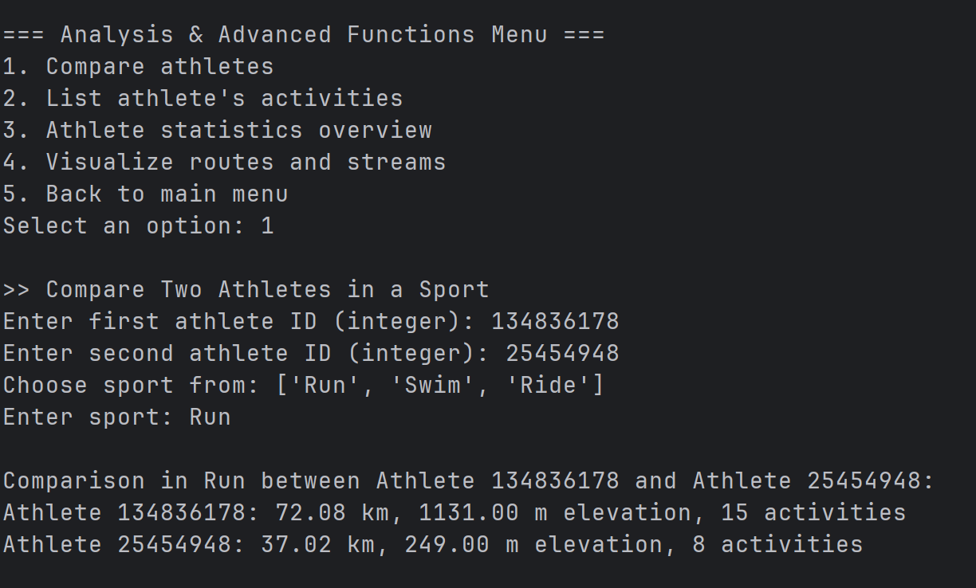
Demo - Menu
1. Athlete Management
View / Add / Edit / Delete Athletes
View Athlete Details & Summary
2. Activity Management
View / Add / Edit / Delete Activities
View Athlete IDs & Activity Details
3. Analysis & Advanced Functions
Compare Athletes
View Activities by Athlete
Statistics Overview
Route & Stream Visualization
4. Exit

Slide 10
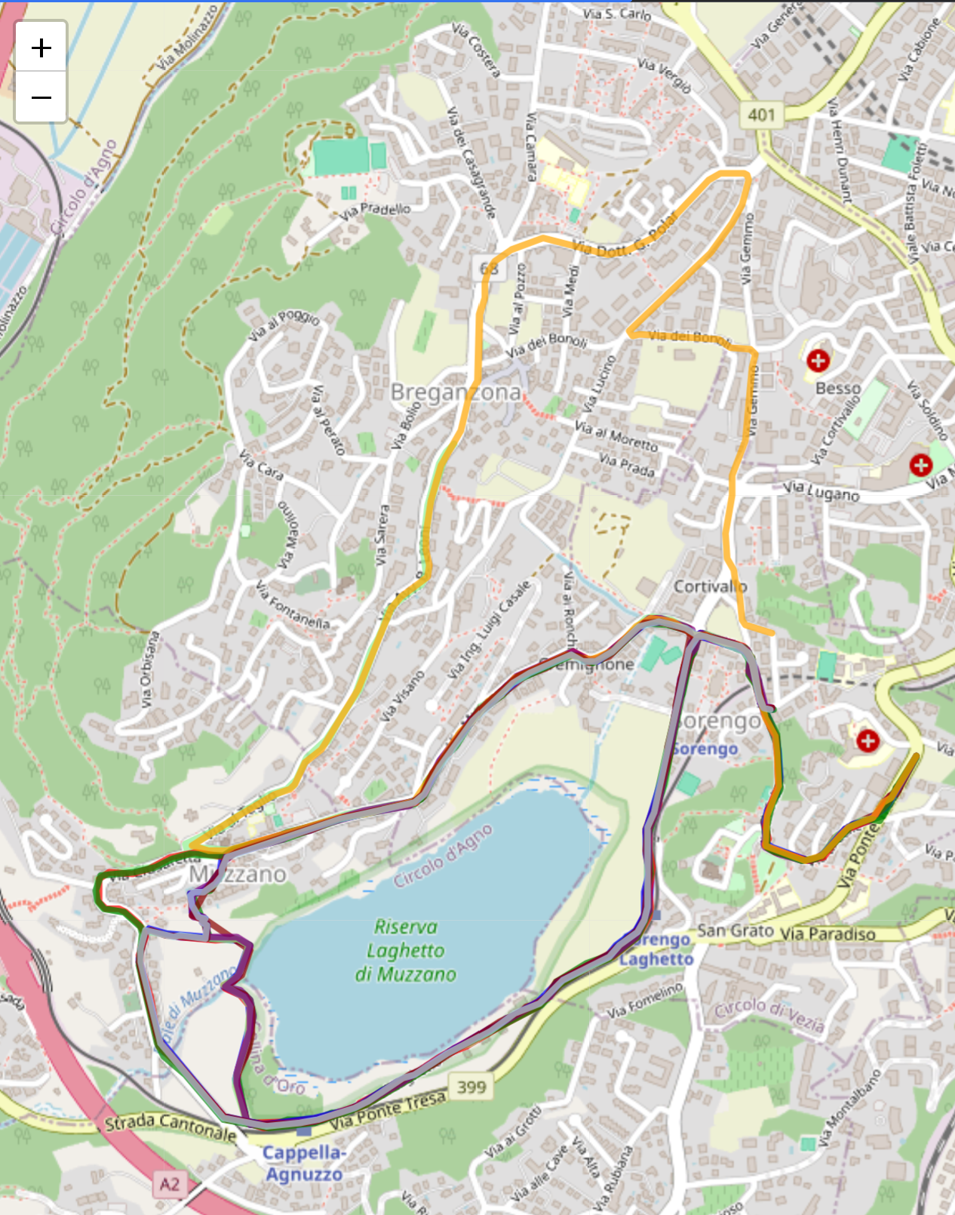
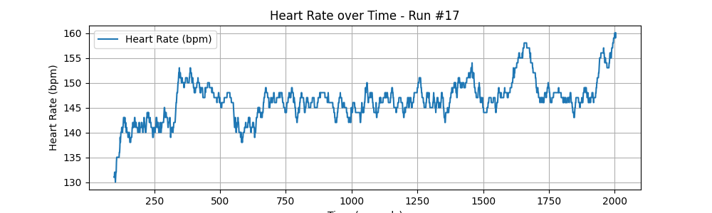
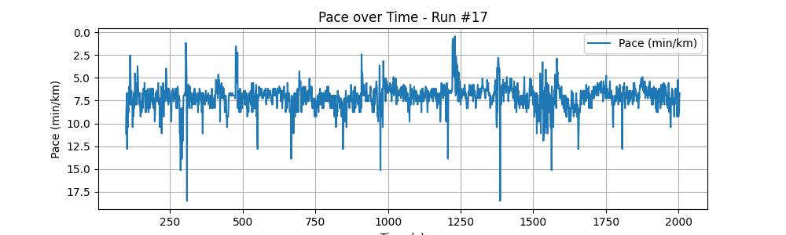
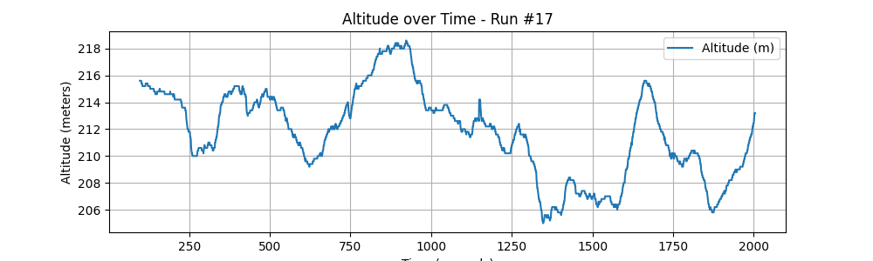
Demo - Activity

Slide 11
What We Achieved
Built a modular system to manage and analyze Strava fitness data
Provided full data control, custom analytics, and visualization tools
Overcame platform limitations and paywalls
Unit-Tested + packaged client and backend

Slide 12
What’s Next?
Real time data sync
Support for additional data sources (e.g Garmin)
ML model for prediction and training plans
Web dashboard or mobile frontend

Slide 13
Conclusion
Designed a client-server app for managing and analyzing Strava fitness data using Flask and MongoDB Atlas.
Developed flexible tools (Python library + CLI) for visualizing and comparing personal activity data.
Handling structured, hierarchical data revealed the benefits of specialized databases (e.g., time-series) for future performance gains.
Solid foundation for future work: real-time processing, machine learning, and integration with new data sources.
Demonstrated the value of custom fitness data solutions beyond commercial platform limitations.

